Slide 1
Core competencies and clinical standards for Internists – A Challenge
Dr. Quazi Tarikul Islam
FCPS,FRCP,MACP
Professor & Head
Department of Medicine
Popular Medical College
Dhaka , Bangladesh
email: prof.tarik@gmail.com

Slide 2
Who is internist ?
Internal medicine physicians are specialists who apply scientific knowledge and clinical expertise to the diagnosis, treatment, and compassionate care of adults across the spectrum from health to complex illness

Slide 3
The roles and abilities of the internist
The principal role of internists is to provide medical care for adults.
Certain professional attributes are required for the
internist to be successful in a rapidly evolving world of medicine.
As a member of a health care team, the internist
has to effectively coordinate the care provided by other professionals for the benefit of the patient.
Internists should also facilitate and support the participation of patients in their own care and aid them in making decisions regarding health Issues..

Slide 4
Contd.
for both individual patients and the community at large.
He or she must be able to communicate clearly with both patients and colleagues alike.
The internist will, in certain situations, require managerial and business skills.
The internist needs to be an advocate on health issues
Finally, internists should be proficient in both teaching and scientific enquiry.

Slide 5
Core competencies of the internist
1. Patient care
2. Medical knowledge
3. Communication skills
4. Professionalism, ethical, and legal issues
5. Organizational planning and service management skills
6. Academic activities — education and research
Core Competencies of the European Internist: A discussion paper, Runolfur Palsson et al; European Journal of Internal Medicine 18 (2007): 104–108

Slide 6
Patient care
Internists need to be capable of providing effective and compassionate patient care that focuses on maintaining health, preventing disease, and diagnosing and treating established illness.
Internists should practice evidence-based medicine supported by sound clinical judgment.

Slide 7
The medical history
Physical examination
Selecting tests in the diagnostic work-up
Establishing a diagnosis
Designing a therapeutic plan
Documentation of clinical findings
Management of medical emergencies
Performing procedures
Prevention

Slide 8
The medical history
The medical interview is the initial step in the diagnostic process. Despite the ever-increasing technology available to physicians for the evaluation of patients, the medical history remains the most important and cost-effective tool.
The internist needs to listen carefully to the patient and to use open-ended questions. They must be capable of recognizing the constellation of symptoms associated with different diseases and be familiar with symptoms suggestive of life-threatening or serious illness.
The internist has to respect confidentiality and be sensitive to personal, cultural, and religious issues.

Slide 9
Physical examination
Internists need to have the ability to perform a thorough and skillful physical examination. Usually, this will be a focused examination guided by the patient's history.
When examining patients, the internist should be empathetic and treat the patient with dignity.

Slide 10
Selecting tests in the diagnostic work-up
In the evaluation of patients, internists need to make rational use of available diagnostic tests. In the selection of tests, they need to weigh the benefits,
potential adverse effects, and cost of each test.

Slide 11
Establishing a diagnosis
Forming and testing hypotheses is a pivotal component of the diagnostic evaluation carried out by internists. In order to establish a diagnosis, the internist has to put together a limited number of unifying hypotheses based on the clinical findings in the case.
The internist attempts to either confirm or reject each hypothesis and thereby narrow the list of differential diagnoses. The internist should be familiar with fundamental aspects of clinical decision-making

Slide 12
Designing a therapeutic plan
Depending on the diagnosis, the internist needs to consider a short-term or long-term management plan based on scientific evidence, clinical judgment, and patient preference
ensure that the selected treatment is cost-effective.

Slide 13
Treatment must be founded on compassion and the best interests of the patient.
internist should discuss the treatment options with the patient (and family members, when appropriate) and respect their preferences.
The internist should discuss the prognosis with the patient and consider limitation of therapy when appropriate, including ‘do not resuscitate’ (DNR)orders.
Internists should also be capable of providing palliative care at the end of life. It is important that they recognize the need of acutely and chronically ill patients for nutritional support and physical therapy.

Slide 14
Documentation of clinical findings
Internists must be able to record the history, physical examination, laboratory studies, problem list, and differential diagnoses in a legible and comprehensive manner.
In addition, a well-reasoned treatment plan should be documented in the record. The format of the case record, quality of information entered, accuracy of the assessment, and the reasoning behind the therapeutic plan are all important issues in clinical documentation.

Slide 15
Management of medical emergencies
Internists need to be able to handle common medical emergencies. They should be familiar with the triage of acutely ill patients based on the severity of illness and should acquire and maintain skills in basic and advanced life support.
Internists should possess the ability to take on the role of the team leader in the emergency setting with the primary responsibility of integrating the care provided by the health care team.

Slide 16
Performing procedures
Internists must have the ability to perform the diagnostic and therapeutic procedures considered essential for the practice of internal medicine
They should be aware of the utility, indications and contraindications, complications, and cost of commonly applied procedures.

Slide 17
Procedures performed by internists may vary between individual physicians, institutions, or countries.
phlebotomy,
collection of arterial blood specimens and analysis of blood gases,
urine analysis,
electrocardiography,
lumbar puncture, Bone marrow aspiration
Thoracocentesis.
However, with evolving technology, internists in some countries have begun to perform procedures that have belonged to subspecialties.
cardiac ultrasound and endoscopy.

Slide 18
Prevention
Prevention of illness is an important task that is central to internal medicine practice.
Internists need to master the principles of primary and secondary prevention.
They should be aware of the benefits and disadvantages of screening and surveillance programs, and they should encourage lifestyle changes and other practices aimed at preventing disease.

Slide 19
Medical knowledge
Internists need to develop a broad knowledge base in internal medicine, information technology, medical management and team leadership, and social sciences.
Internists should understand the relevant scientific background and pathophysiology of the diseases they commonly manage and be capable of applying these in clinical practice.
They should also be familiar with the key principles of clinical epidemiology and biostatistics.

Slide 20
Internists need to know the principles of evidence-based medicine and the use of clinical guidelines in the management of patients.
They should be familiar with benefits and problems associated with guidelines and how their use relates to the care of individual patients.
Internists should be able to read the medical literature in a critical manner.

Slide 21
Communication skill
Communication skills required for obtaining a medical history
Internists should be capable of explaining carefully to patients and their families the results of the diagnostic process and the treatment required.
Clear description of the appropriate therapeutic measures, including the explanation of the effects of medications, their efficacy, side effects, and interactions.
Internists should be able to involve patients in the decision making process and to offer them rational choices when possible.
Internists should also be able to communicate effectively with other physicians and health care professionals using verbal, written, and electronic media

Slide 22
Professionalism, ethical, and legal issues
Internists should be familiar with the principles of professional behavior as outlined by the Charter on Medical Professionalism published jointly by
Medical Council
College of Physicians
Society of Medicine
Physician’s Association

Slide 23
They should honor the principles of confidentiality, altruism, autonomy, and social justice in the practice of medicine.
Internists should put patients’ well-being first and
exhibit responsible attitudes toward society.
They should respect the views of patients and act with honesty, empathy, and sensitivity.

Slide 24
They should promptly inform patients (or their relatives) if a medical error occurs.
Internists should display sensitivity to diversity in the community with respect to religion, culture, and socioeconomic status.
They should practice medicine according to methods of best practice guidelines.
They should be conscientious and recognize the
importance of attention to detail. Internists need to understand the importance of lifelong learning.

Slide 25
They should recognize their personal limitations and be open to constructive criticism.
They should respect colleagues and be willing to consult them when needed.
Internists should maintain comprehensive, timely, and legible medical records.

Slide 26
Organizational planning and service management skills
Internists should apply evidence-based and cost-effective strategies to the prevention, diagnosis, and treatment of disease.
They should be capable of utilizing the resources,
providers, and systems necessary to provide optimal patient care.
Internists should be familiar with the essence of collaboration and teamwork in medicine.

Slide 27
They need to know how a team works effectively and how to be a team leader.
Internists should be familiar with the relevance and benefit of clinical governance and be willing to accept professional regulations and assessment of performance.
Internists should be aware of time-management strategies.
They should make effective use of available resources and search for ways to cope with bureaucracy. Internists should facilitate the implementation of quality programs in the clinical practice setting.

Slide 28
Academic activities — education and research
Graduate and postgraduate teaching
Teaching medical students and postgraduate trainees in internal medicine is a fundamental task of internists.
They have to be familiar with advances in education, including problem-based learning as well as assessment and feedback.
Internists need to serve as mentors and role models for students and physicians in training. They should also possess skills to deliver an effective presentation when teaching in a lecture format.

Slide 29
Continuing education
Internists should demonstrate commitment to continuous professional development.
The internist should always recognize personal errors and attempt to learn from them. He or she should become familiar with the use of information technology to access information and facilitate educational activities.
The internist should identify areas for improvement and implement strategies, based on scientific evidence, to enhance patient care.

Slide 30
Clinical and basic research
Internists must be familiar with the scientific basis of
medicine and the use of scientific method in medical
research.
They should understand the fundamental aspects of
biomedical science and its application in research.
They should also be able to critically review the results of research studies.
Internists should have the ability to report clinical
findings or results of research studies.

Slide 32
Standards of care
A standard of care can also refer to
  Informal or formal guidelines generally accepted in the medical community
  Developed by a specialist society or organization
  Sometimes simply developed over time or as the result of clinical trial findings
  That standard care, experts would agree with as most appropriate or "best practice"

Slide 33
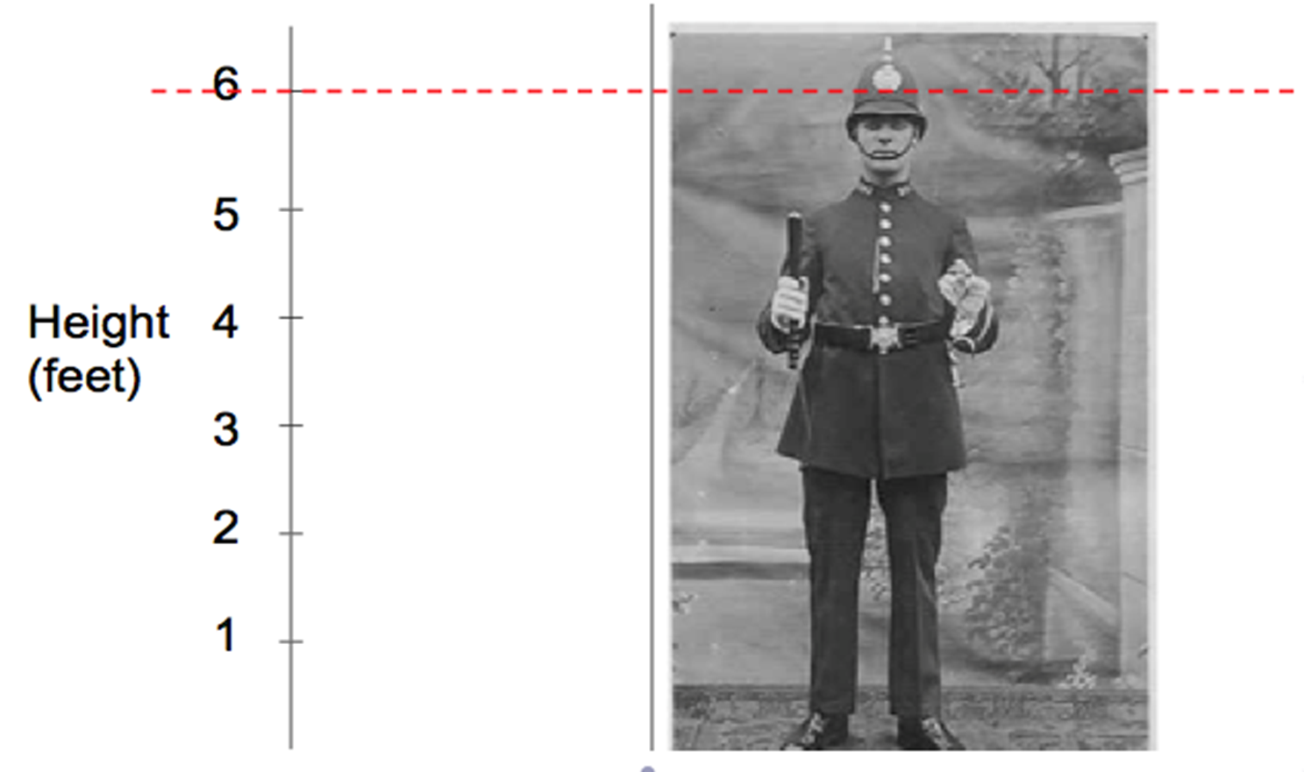
What is Standard ?

Slide 34


Slide 35
A Clinical Care Standard is a small number of quality statements that describe the care patients should be offered by health professionals and health services for a specific clinical condition or defined clinical
pathway in line with current best evidence.

Slide 36
A clinical care team for a given patient consists of the health professionals—physicians, advanced practice registered nurses, other registered nurses, physician assistants, clinical pharmacists, and other health care professionals—with the training and skills needed to provide high-quality, coordinated care specific

Slide 37
Definition of Standard of care
1. A diagnostic and treatment process that a clinician should follow for a certain type of patient, illness, or clinical circumstance. (New England Journal of Medicine, 2004)
2. In legal terms, the level at which the average, prudent provider in a given community would practice. It is how similarly qualified practitioners would have managed the patient's care under the same or similar circumstances.

Slide 38
Why clinical care standard is needed?
Avoid malpractice
Develop professionalism
Provide uniform standard care in clinical medicine

Slide 39
Need for clinical standard care
Disease patterns and other bio- ethical issues are different in different countries
Needs standard clinical care for each countries
Regional guidelines for specific diseases; e.g. Dengue guideline for Indian sub continent.

Slide 40
Standard care needs standard settings
Country wise
Region wise
Disease pattern wise

Slide 41
Over the past decade, clinical guidelines have increasingly become a familiar part of clinical practice
Every day, clinical decisions at the bedside, rules of operation at hospitals and clinics, and health spending by governments and insurers are being influenced by guidelines
The development and implementation of (evidence-based) clinical practice guidelines - is one of the promising and effective tools for improving the quality of care

Slide 42
However, many guidelines are not used after dissemination
Implementation activities frequently produce only moderate improvement
The guideline recommendations are followed in on average 67% of the decisions
There is a large variation between different physicians and between different guidelines

Slide 43
In our setting( Bangladesh)
Strong points
  Clinical diagnosis
  Management of emergencies despite constrain
  Skilled at medical procedures
  Universal health coverage program
Weak points
  Documentations (Set Clinical audit)
  Evidence based practice
  Lack of awareness in prevention
  Inadequate health budget

Slide 44
In our setting( Bangladesh)
Professionals are busy with multifaceted work load
Lack of motivation
No health insurance policy
No legal binding for use of guidelines
Clinicians are confident on clinical diagnosis based on their long experience

Slide 45
In our country
Majority of clinical care guidelines have adopted from international guidelines for non communicable diseases (DM, HTN, IHD, COPD, Bronchial Asthma, COPD, Malignancy so on)
Regarding infectious diseases - own guidelines on the basis of evidence but enlightened from WHO guideline (Dengue, Chikungunya, Filaria, Malaria, Vis. Lieshmania, Diarrhea, and so on) prepared by the specialist in collaboration with the disease control center of health services

Slide 46
Rule and Role
Rule and role of professional bodies
There are some individual professional bodies/societies initiatives
Central professional bodies like Bangladesh Medical Association have no rule and role

Slide 47
Countries in Asia
KSA
Oman
Israel
UAE
Singapore
Thailand
Japan
China
South Korea
Good clinical standard care

Slide 48
The changing face of internal medicine: patient centered care
Patient centered care is the gold standard and ‘no decision about me, without me’
A ‘goal-oriented’ principle should consider in complex multi-morbidities
The barrier is deeply rooted in a disease-outcome-based paradigm

Slide 49
The culture of modern medicine has prioritized optimal disease management according to guidelines and population goals without asking what patients want
Doing ‘what is right for the patient’ should be based on trust
Patients and internists must therefore meet as equals: ‘I’ and ‘you’ should be replaced by ‘we’

Slide 50
Standardized framework for adaptation needed
Methods and principles for developing high quality guidelines
  Now well established
  Though no internationally accepted method available for adapting them to local contexts
  Few need to evaluate the rigor, efficiency, and transparency of proposed processes according to a recent review

Slide 51
Lack of international standards can lead to recommendations adapted on the basis of tradition, anecdote, or poor quality evidence
Mitigation of this risk can be possible by
  Improving documentation
  Involving methodologists to translate evidence to recommendations

Slide 52
Variables/Determinants
Health budget
Per capita expenditure on health
Political commitment of the government
Social context
Race/ethnicity

Slide 53
Conflicts – how to solve ?
ADA/IDF/WHO
AHA/ESC/WHO
ARA/ILAR
ATS/GOLD
ISN/AAN

Slide 54
Way to Success
Even in 21st century, despite all of the advances, the patient–physician interaction remains the cornerstone of the practice of internal medicine
Incorporation of core competencies in training curricula throughout the globe is now vital.
Patient centered care, guidelines and population goals, ‘goal-oriented’ principle etc. are essentials
Needs a collaborative effort to develop and endorse a consensus

Slide 55


